Slide 1
THE HIDDEN DANGERS INSIDE THE PLATFORM

Slide 2

Who are we

Slide 3

Classic platforms
Notes:
Pictures of boards

Slide 4
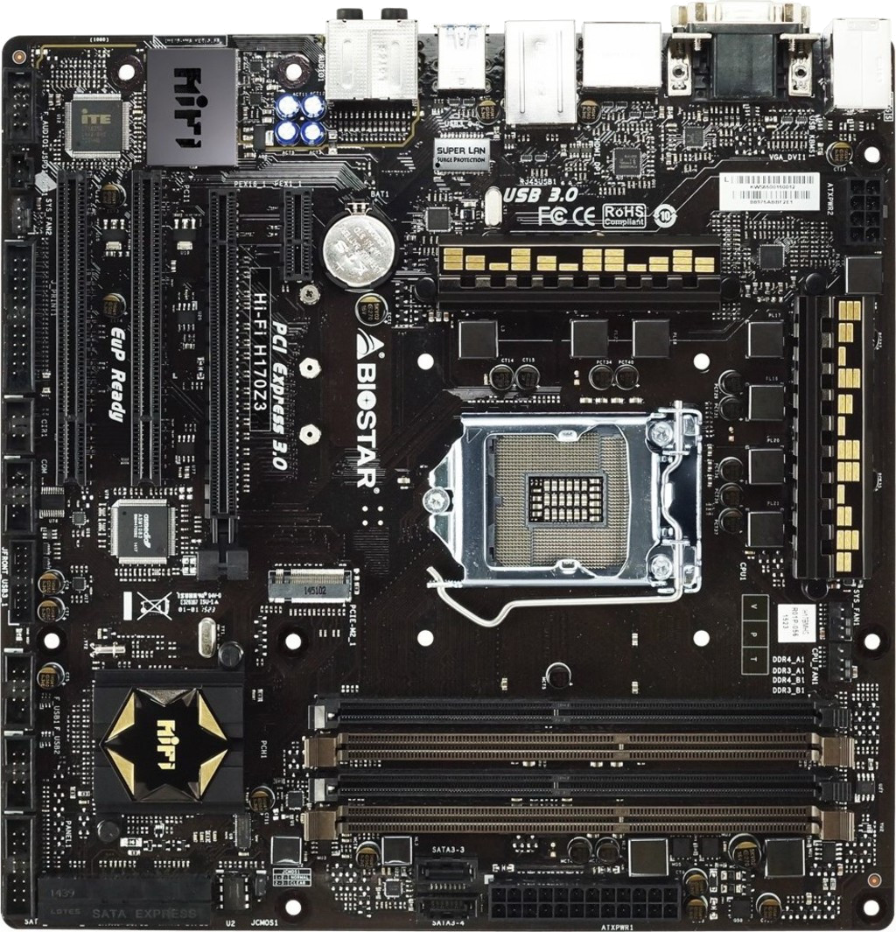
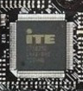
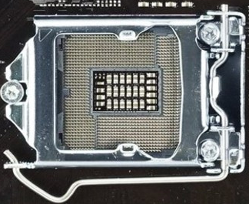
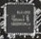
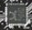
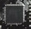

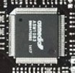
Classic platform
Notes:
Pictures of boards

Slide 5
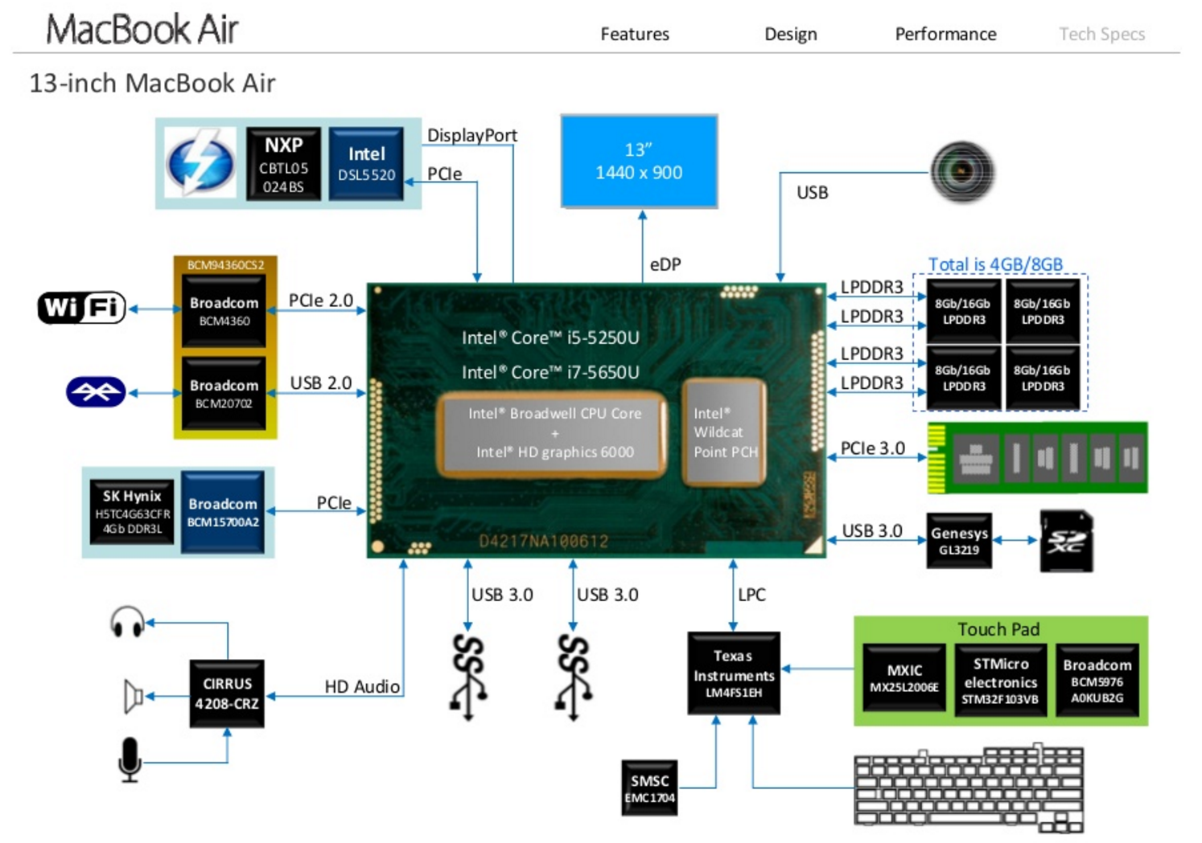
Modern platform

Slide 6
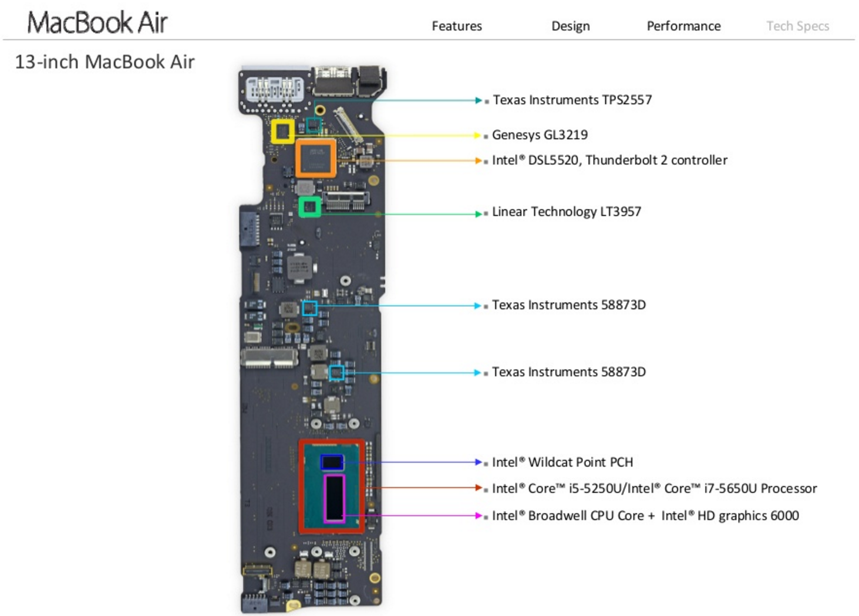
Modern platform

Slide 7
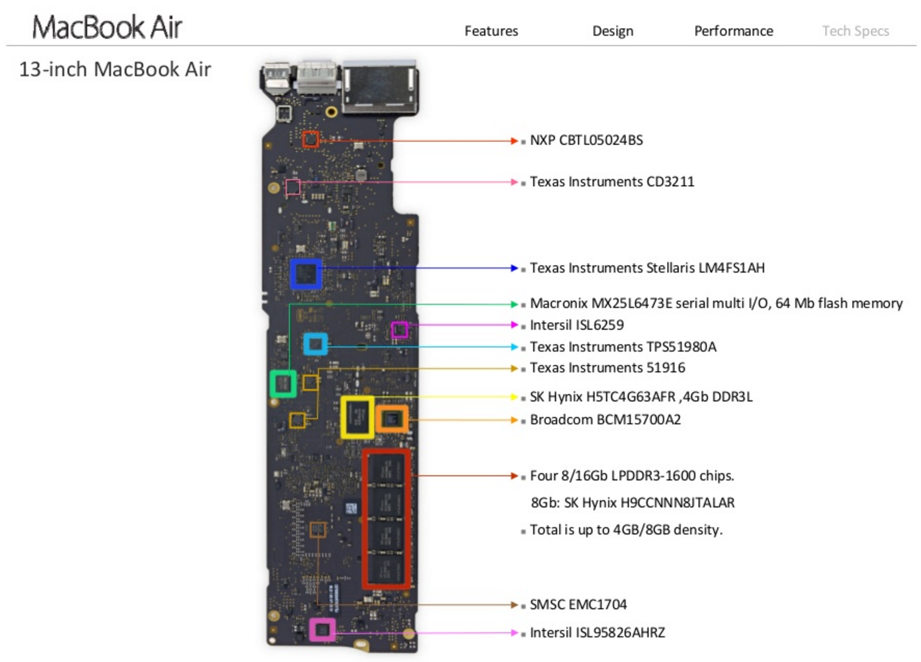
Modern platform

Slide 8
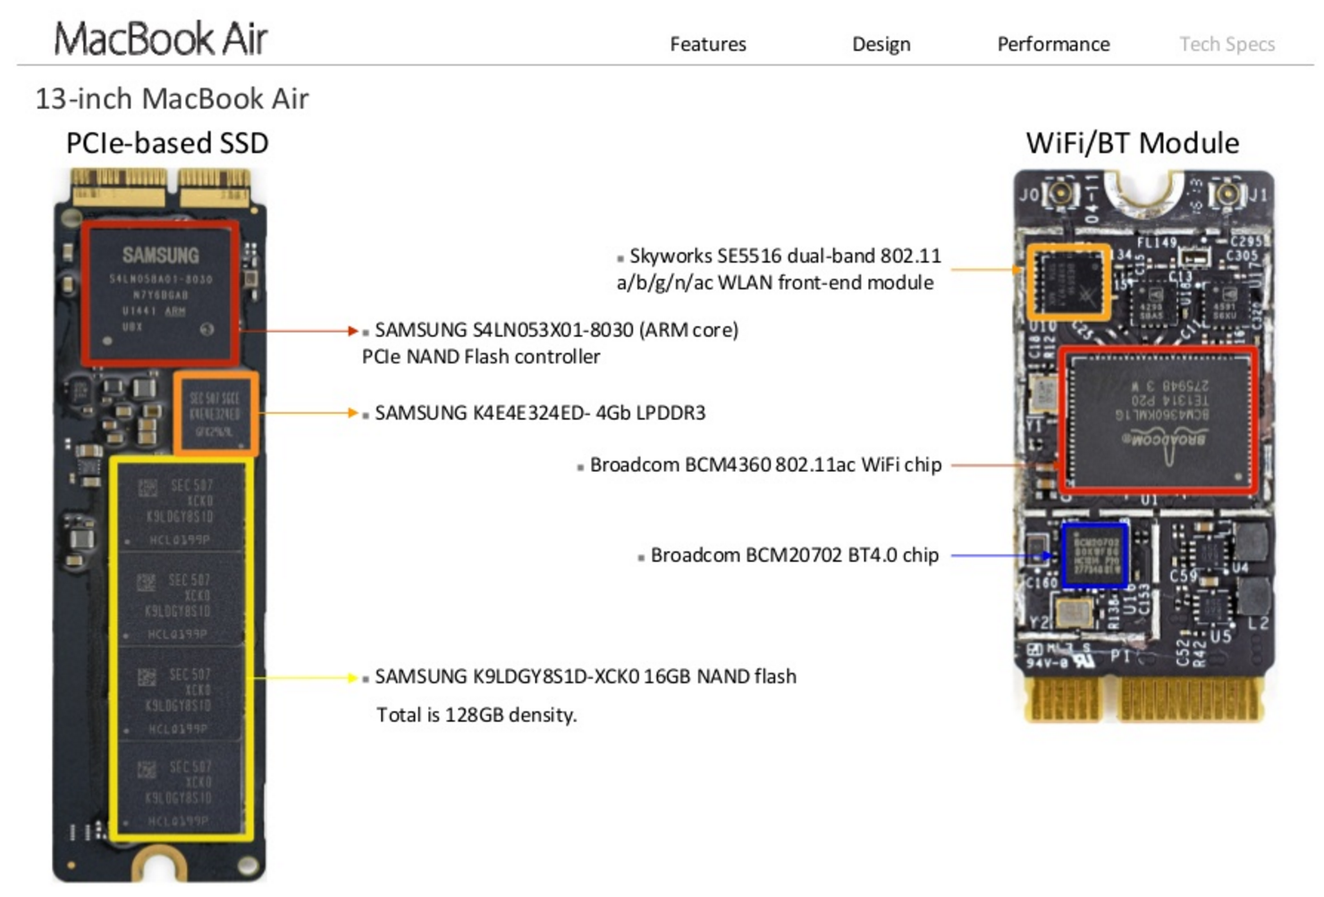
Modern platform

Slide 9
Attackers motivation

Slide 10
Attackers motivation
Stealth
Persistence
Low level security bypass
Data intercepts (USB)
Side channel spying (sensors etc.)
Privilege escalation
VM escape

Slide 11
Attack surface review from the inside
Notes:
Show ifix it teardowns
We all know about the BIOS let’s move on.
Refrence Yuri’s work and Xeno, mention examples.
Interfaces:
UART
PCI devices
GPU
Network
I2C – jesse (to check if can be discussed ) the EC?
SPI
I2C
LPC
USB perphrials
SOC
$#17 is on die yo!
So many things!
teardown and how many other CPU’s are on a platform.

Slide 12
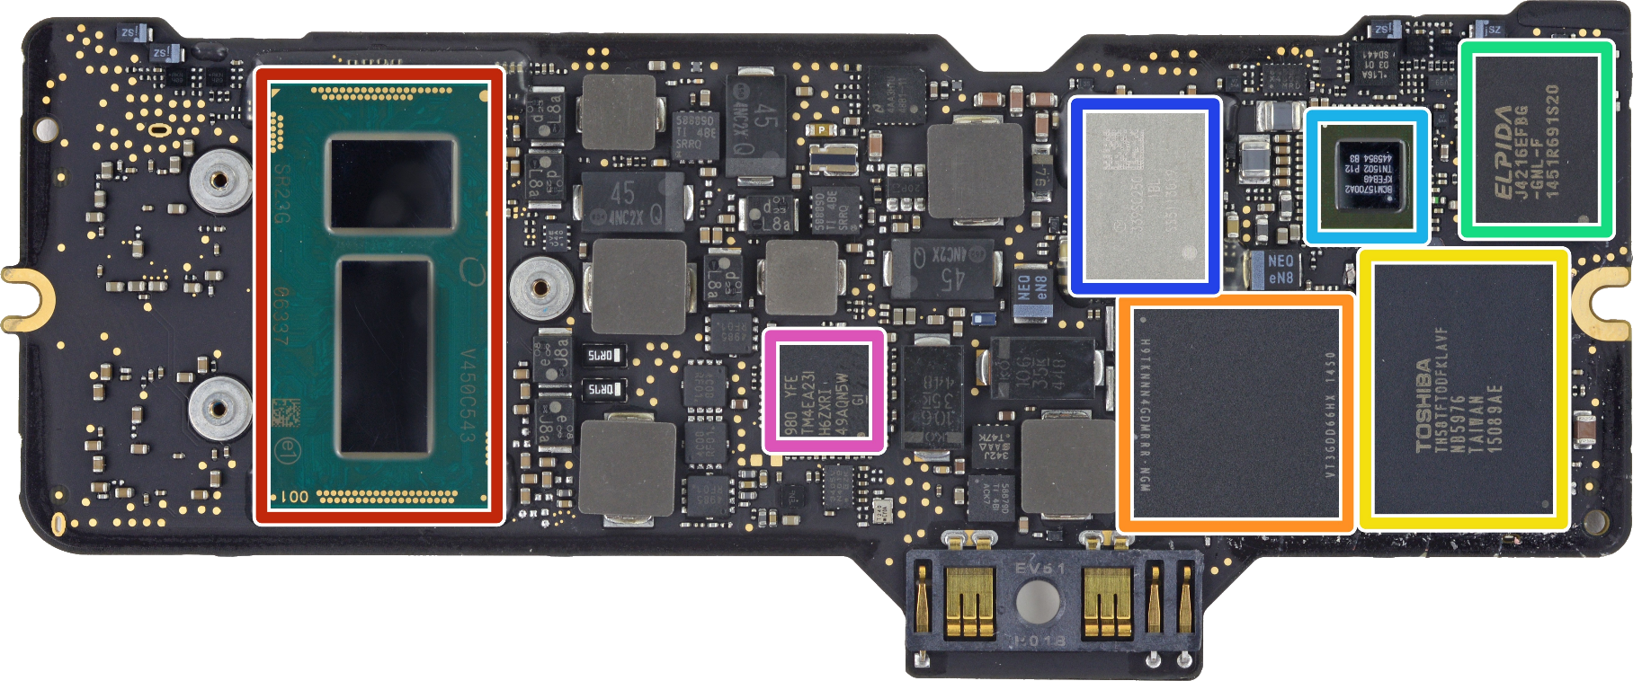
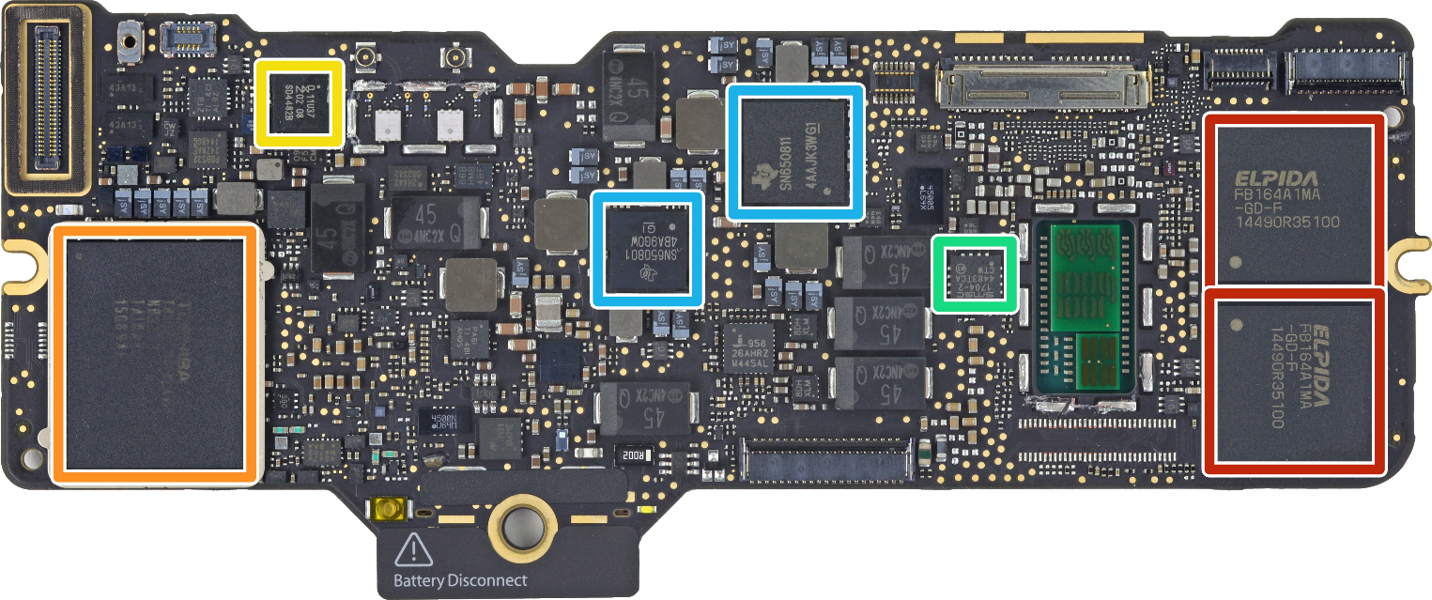
Modern platform
Notes:
Retina macbook 2015
Elpida/Micron FB164A1MA-GD-F 8 GB LPDDR3 Mobile RAM
Toshiba TH58TFT0DFKLAVF NB2953 128 GB MLC NAND Flash memory (+ 128 GB on the reverse side for a total of 256 GB)
NXP 11U37 microcontroller; 128 kB flash, 10kB SRAM
SMSC 1704-2 Temperature Sensor
Texas Instruments SN6508 (probably power converter related to SN6501)
Intel SR23G Core M-5Y31 CPU (Dual-Core, 1.1 GHz, Turbo Boost up to 2.4 GHz) with Intel HD Graphics 5300
SK Hynix H9TKNNN4GDMRRR-NGM 4 Gb (512 MB) LPDDR2-SDRAM
Toshiba TH58TFT0DFKLAVF 128 GB MLC NAND Flash
Elpida/Micron J4216EFBG-GNL-F DDR3 SDRAM
Broadcom BCM15700A2, appears to be a wireless networking chipset
Murata 339S0250 (Likely an iteration of the 339S02541 Wi-Fi module found in theiPad Air 2)
Texas Instruments/Stellaris LM4FS1EHSMC Controller (Replacement codename for TM4EA231)

Slide 13
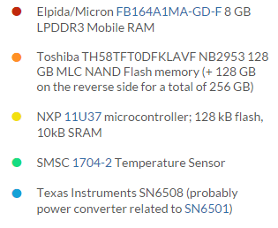
Modern platform
Hide a tiny amounts of data in SPD
OLD attack – change SPD to indicated smaller RAM size and cause memory to wrap around

Slide 14
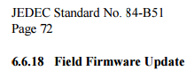
Modern platform
JEDEC eMMC spec 5.1
Introduced FFU
FIELD FIRMWARE UPDATE

Slide 15
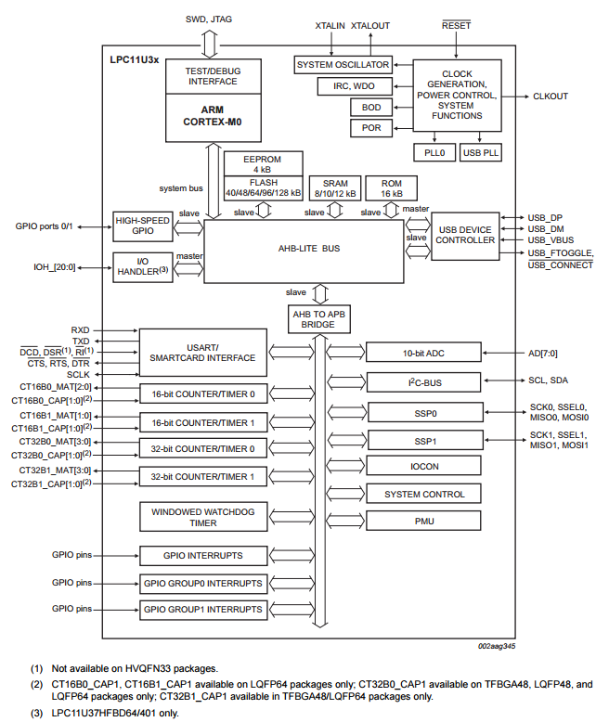
Modern platform

Slide 16
Modern platform

Slide 17
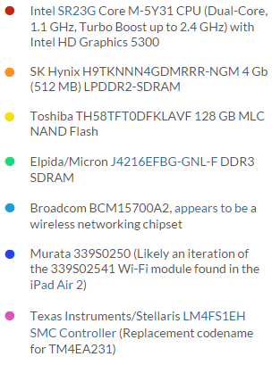
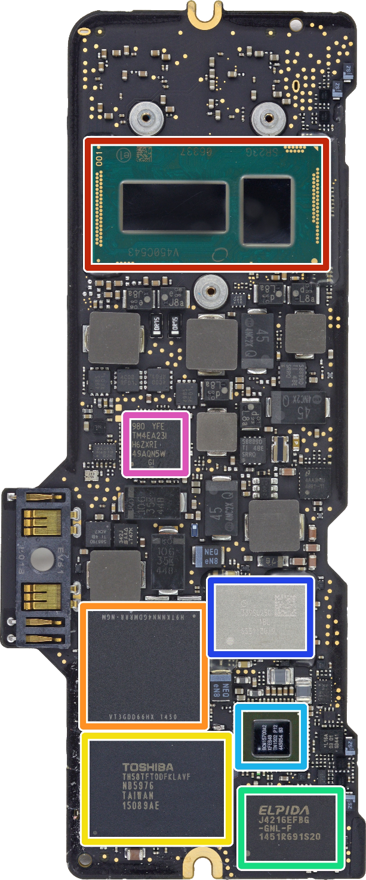
Modern platform

Slide 18
Modern platform

Slide 19
Modern platform

Slide 20
Modern platform

Slide 21
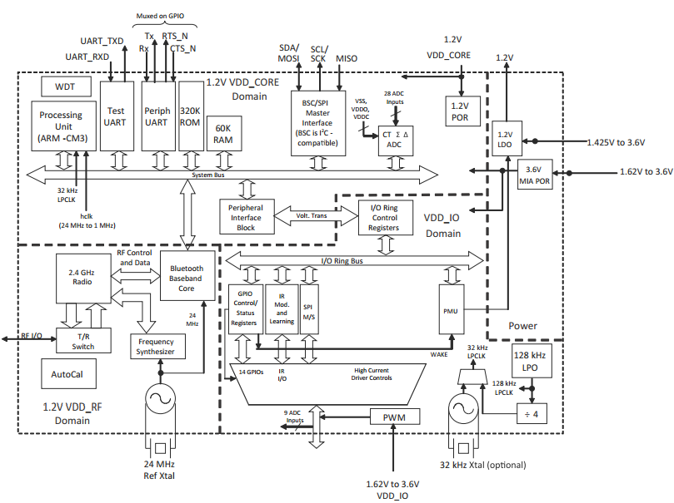
Modern platform

Slide 22
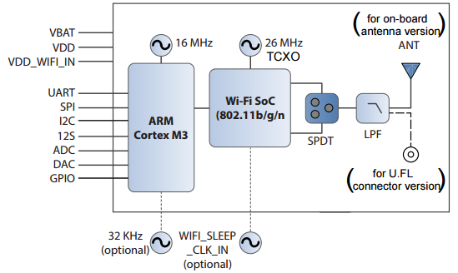
Modern platform

Slide 23
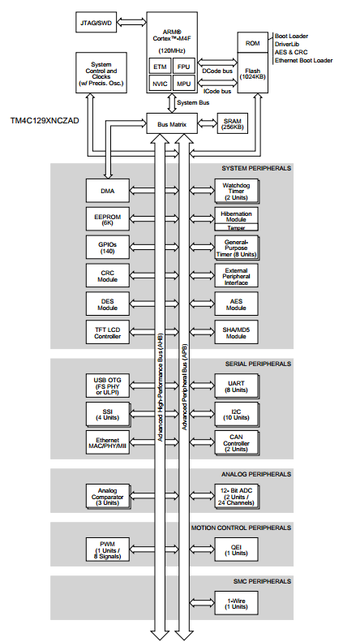
Modern platform

Slide 24

Modern platform
The curious case of “pluggable”
USB 3.0 SATA dock for external HDD
Controller used is made by asmedia
Release a firmware update tool and patch back in 2013
http://plugable.com/2013/03/05/usb3-sata-u3-firmware-update

Slide 25
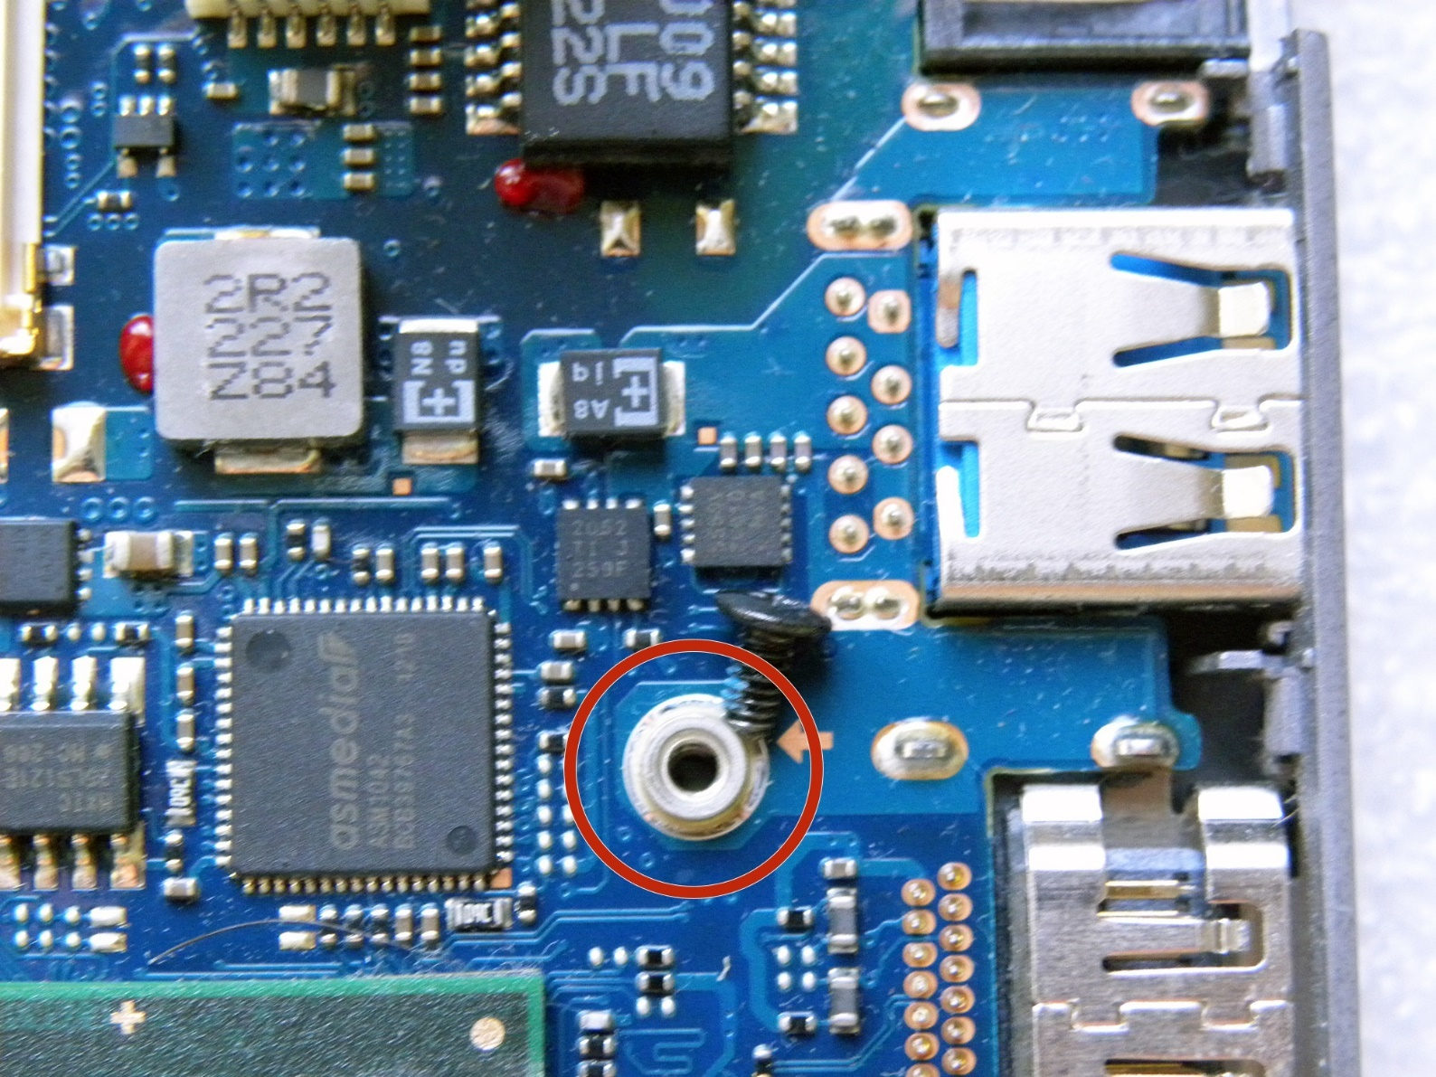
Modern platform
Notes:
Samsung teardown, picture with asmedia controller
https://www.ifixit.com/Guide/Disassembling+Samsung+Laptop+Ultrabook+NP530U3B/23322

Slide 26
Example
Malware gets installed on a platform via phishing etc.
It detects a vulnerable platform component.
Then uses that component for persistence on the device.
Notes:
USB LTE card demo

Slide 27
DEMO
Internet
AV
Platform
Internal LTE module
Malware C&C
Malware
Notes:
USB LTE card demo

Slide 28
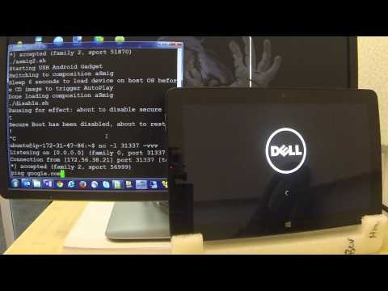
Notes:
USB LTE card demo

Slide 29
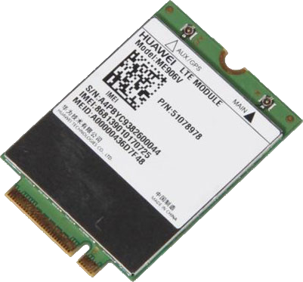
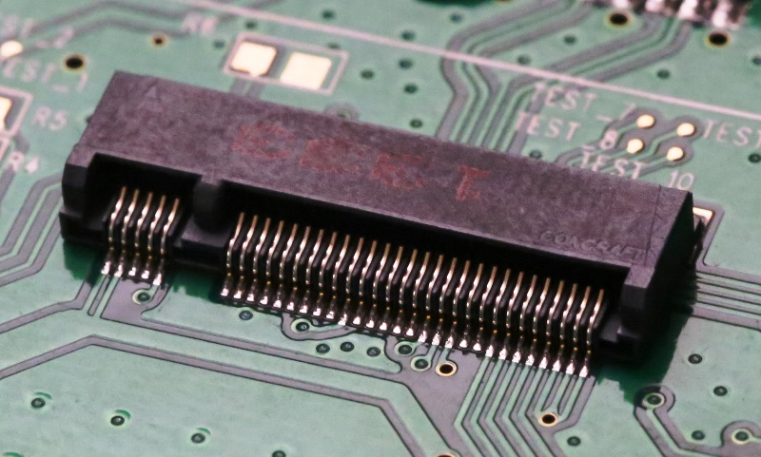
Internal Huawei LTE modem
Connected via USB interface in M.2 socket

Slide 30
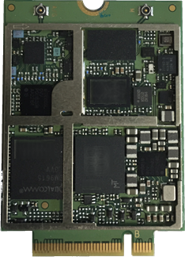
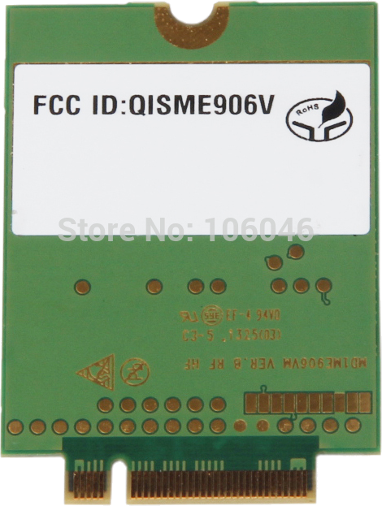
Software
Windows utility for firmware updates
Firmware
Strings is useful
Hardware
Test pads?

Slide 31
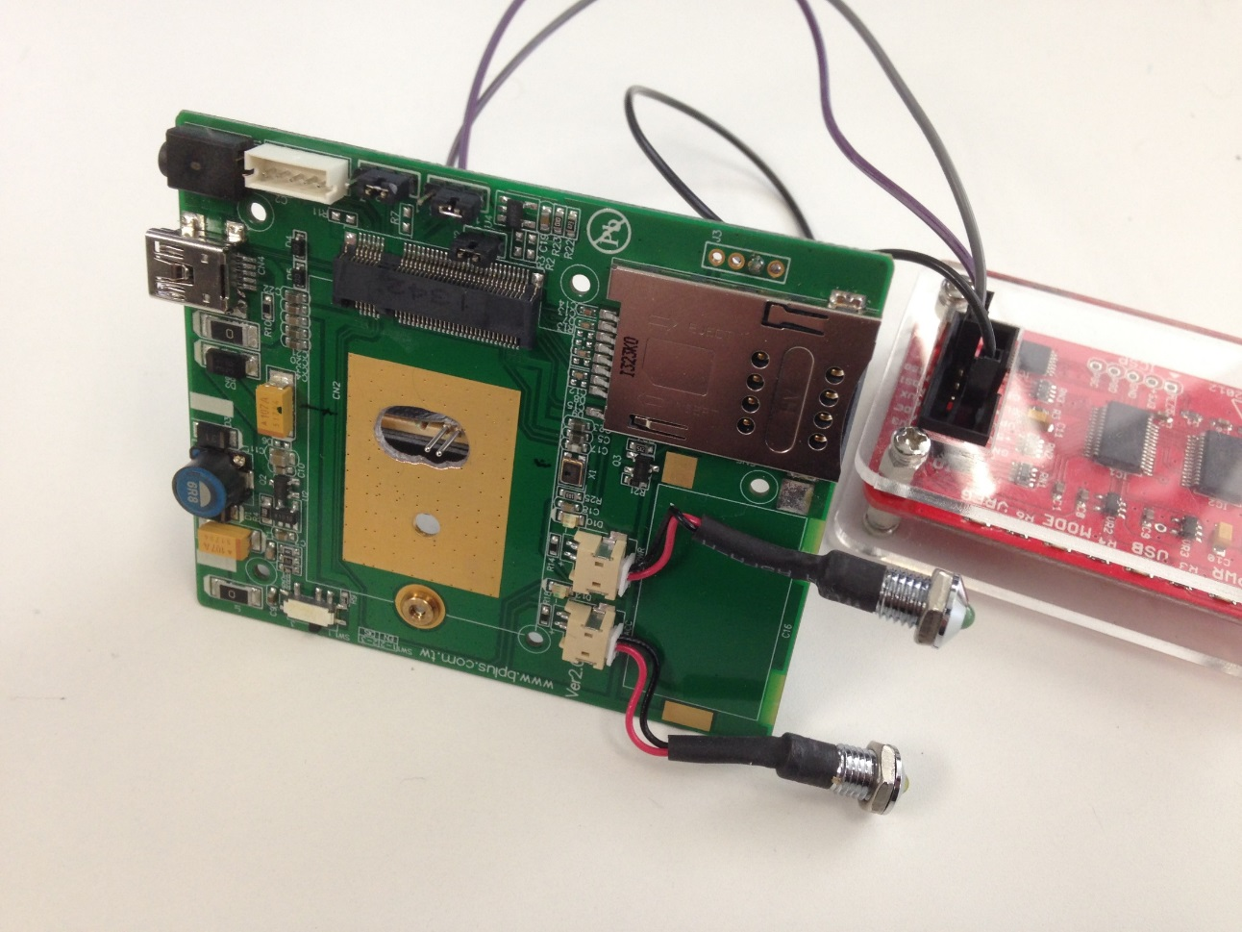
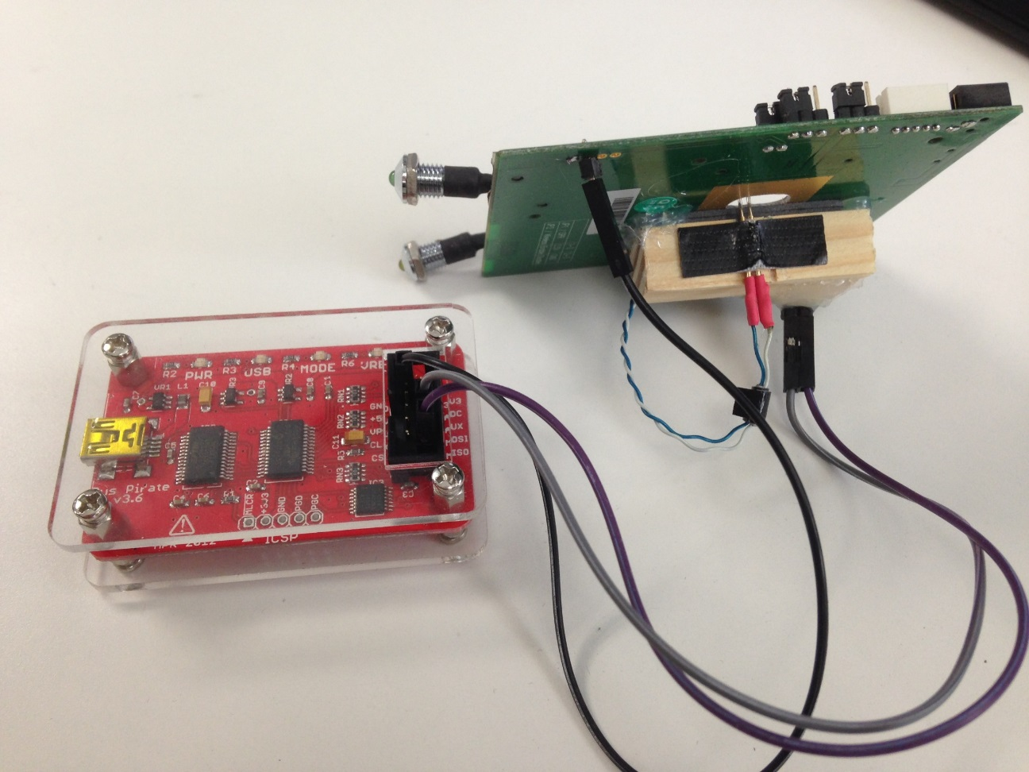

Slide 32

CVE-2015-5367: Insecure Linux Image in Firmware
CVE-2015-5368: Insecure Firmware Update Authentication
Notes:
Disclosed vulnerabilities and breakdown

Slide 33
All of the affected products:
Huawei
ME906V/J/E
HP
HP EliteBook 725 G2,HP EliteBook 745 G1,HP EliteBook 755 G2,HP EliteBook 820 G1,HP EliteBook 820 G2,HP EliteBook 840 G1,HP EliteBook 840 G2,HP EliteBook 850 G1,HP EliteBook 850 G2,HP EliteBook 1040 G1,HP EliteBook 1040 G2,HP EliteBook Folio 9470m,HP EliteBook Revolve 810 G2,HP EliteBook Revolve 810 G3,HP ElitePad 1000 G2,HP Elite x2 1011 G2,HP ProBook 430 G1,HP ProBook 430 G2,HP ProBook 440 G0,HP ProBook 440 G1,HP ProBook 440 G2,HP ProBook 450 G0,HP ProBook 450 G1,HP ProBook 450 G2,HP ProBook 640 G1,HP ProBook 645 G1,HP ProBook 650 G1,HP ProBook 655 G1,HP Pro x2 612 G1,HP Spectre x2 13-SMB Pro,HP ZBook 14,HP ZBook 14 G2,HP ZBook 15,HP ZBook 15 G2,HP ZBook 15u HP ZBook 17,HP Zbook 17 G2,mt41 Thin Client
Notes:
Disclosed vulnerabilities and breakdown

Slide 34
Thanks for your research and for giving the DefCon talk. I was there in the
audience.
Huawei is refusing to provide the ME906 firmware update directly to end users.
Instead, they refer to the OEM partner (Sony, etc.), who in turn knows nothing
about this. It's a classic case of finger pointing.
Do you have any insight and/or suggestions on how an end user of one of these
LTE modules can acquire the patch? In my case, it's the Sony variant.
Thanks in advance for your assistance. Please excuse the anonymous disposable
email, but I'm sure you know it's the only way to remain secure.
Regards,
A (Disgruntled) Huawei Modem Owner
Notes:
Disclosed vulnerabilities and breakdown

Slide 35
Questions?

